Slide 1
DIGITAL JUKEBOX
WELCOME
Salim Dhahri & Jay Phillips

Slide 2
Table of Contents.
01 Purpose
02 Process
03 Live Demo
04 Reflection
05 Future Work
06 Q&A

Slide 3
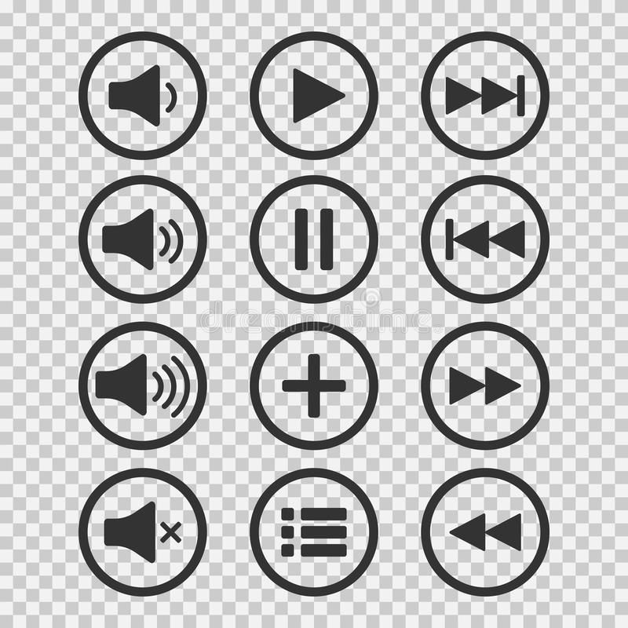
Purpose
To select from and play multiple 8-bit songs using the ATMega328P microcontroller
External Input:
Play/Pause Toggle Button
Next Song Button
Previous Song Button
Internal Input:
Music Notes
Output:
Music

Slide 4
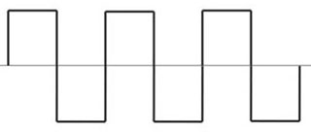
Sound Waves
Square Waves

Slide 5
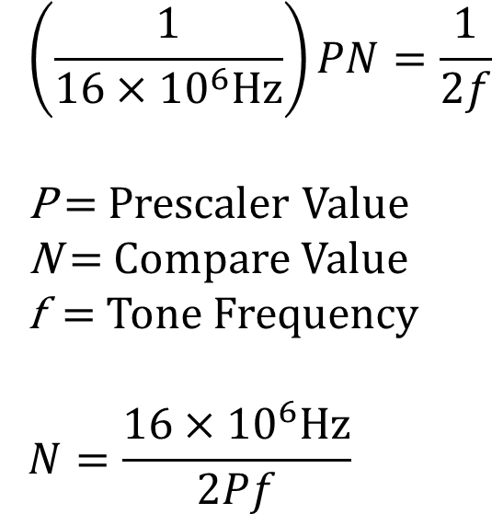
From Frequency to Hex

Slide 6
LIVE DEMO
100%
25%
75%

Slide 7
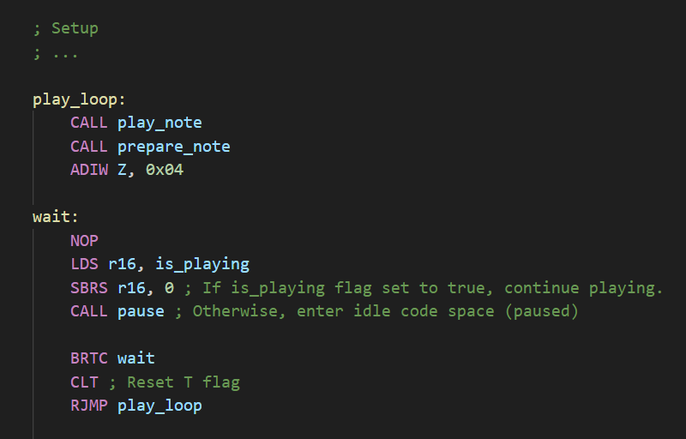
600+ lines of code
15+ subroutines
3 interrupts
49 frequency values in Flash
2 songs in Flash

Slide 8
Reflection
ELEPHANTS
What would we have done differently?
Implementing the pause functionality in the subroutine.
Wait to implement the PWM until we collect multiple notes at a time.
Notes:
1st: With that, the main function would be shorter even though it’s already 30 lines in a 500-line code
2nd: Avoiding the implementation of a component before making sure we actually need it: PWM for multiple notes

Slide 9
Future Work
Short term
Long term
Using the BubbleSort to sort frequencies of multiple notes.
Work with different waveforms.
MORE MUSIC
Notes:
1st: In case we wanted to play a more complex song where notes overlap

Slide 10
Q&A
This is where you section ends. Duplicate this set of slides as many times you need to go over all your sections.

Slide 11
Thank you!
THANK
YOU

Slide 12
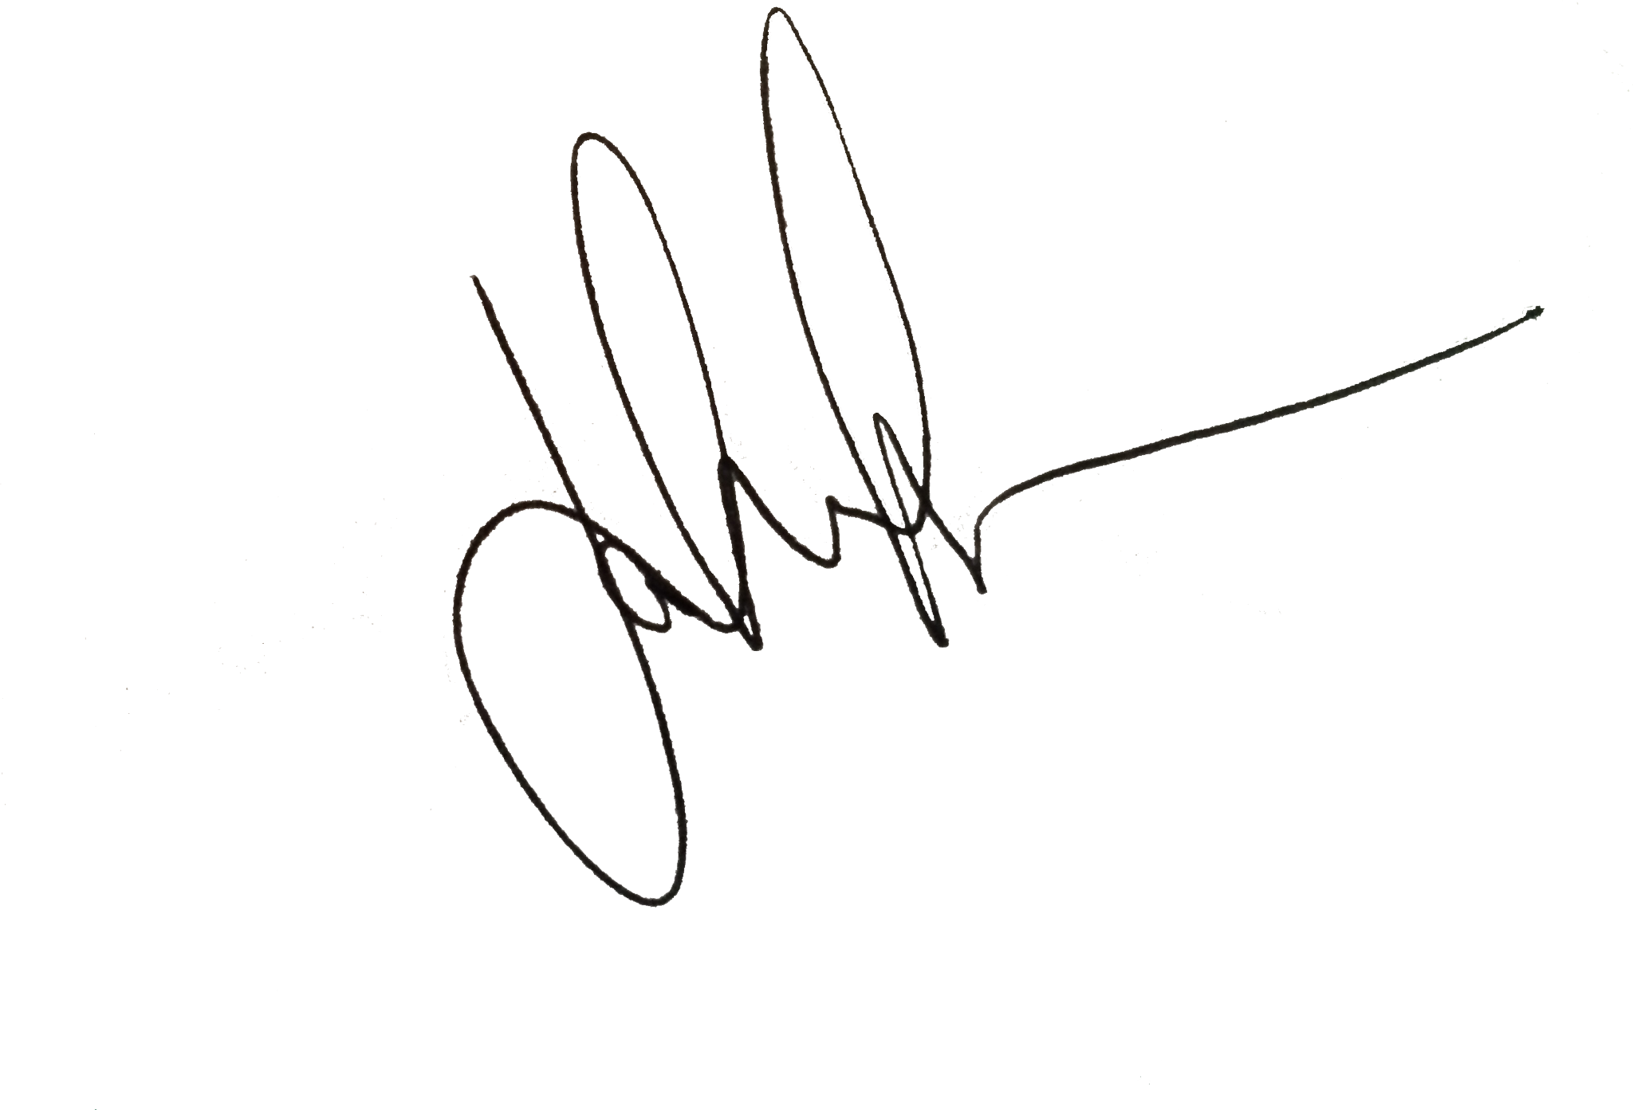
CONGRATULATIONS
Certificate of Completion
Salim Dhahri & Jay Phillips
You have successfully completed:
This course.
01/18/2022
Date
Signature

Slide 13
Editable Icons

